Slide 1

Angular
Knowing the basics of framework

Slide 2
WTF is Angular?
Angular is a developer platform, to create web apps.
It’s composed by:
Component-based framework for building web applications
Collection of well-integrated libraries that covers a wide variety of features
A suite of developers tools to help development

Slide 3

















Why Angular is considered framework and not lib?

Slide 4

As Jack The Ripper would say...
Let’s go by parts:
CLI: creating app and application elements
Components
Directives
Pipes
Services
Modules

Slide 5


Slide 6
CLI: creating application boilerplate
The angular command line interface (cli) is a tool that help us to create all boilerplate we need to create an application, component, module…
First of all we need to install it: npm install @angular/cli -g
Then we can use it to create our application running: ng new my-awesome-app
Now we can navigate to the application folder: cd my-awesome-app
Finally we run a command to serve our app: ng serve

Slide 7
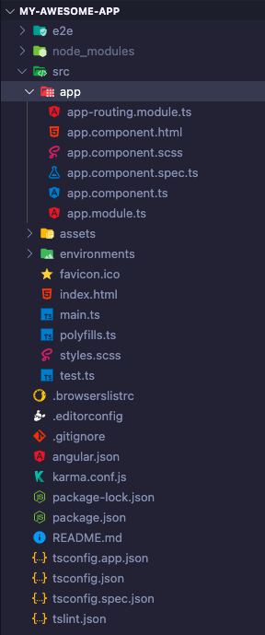
App scaffolding
We have some important points in the create structure, let’s see
angular.json file is the definition of our project
On styles.css we can write css rules that will affect our whole application
tsconfig.json has the information of how we transpile our app to js
The App folder will contains all files that we use to create our application
app.module.ts is our initial module of application (we will see what is a module later).

Slide 8
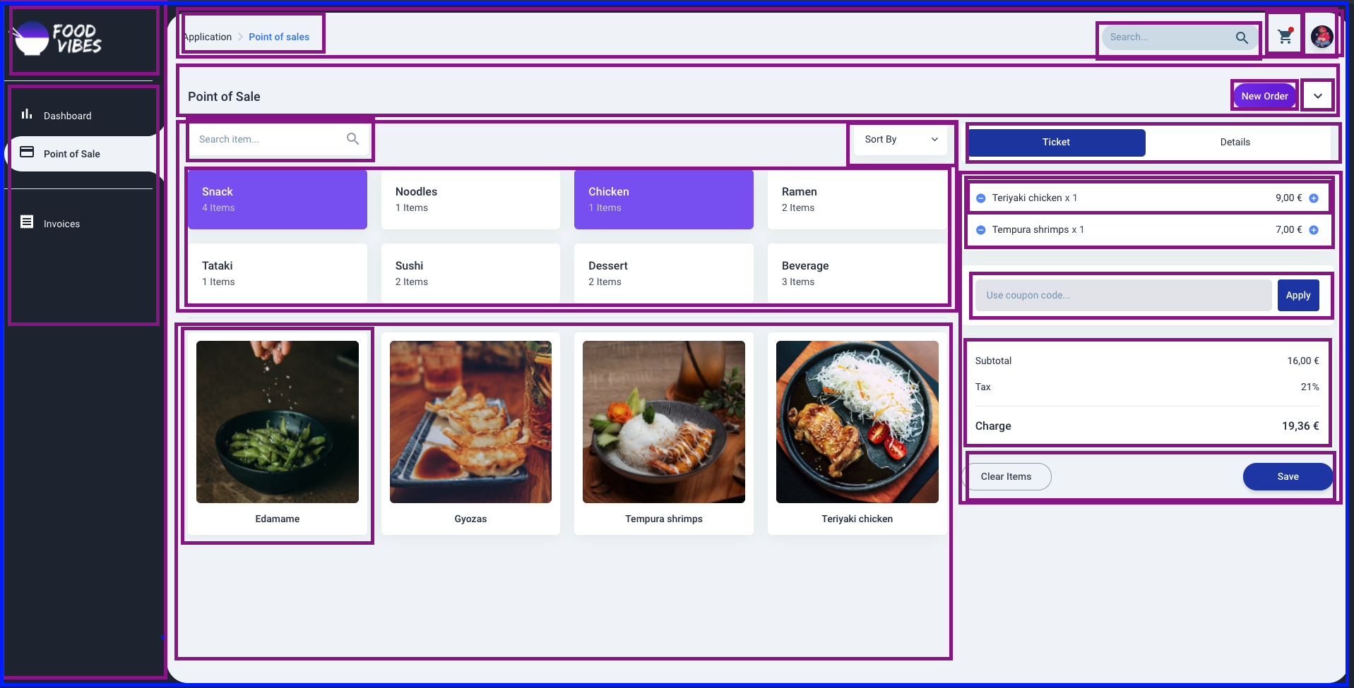
Components: What is a Component?
They are every part that represents anything of our application.

Slide 9
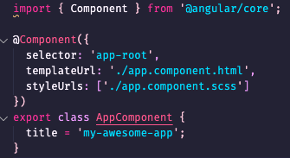
Components: What is a Component?
A Component is a class with @component decorator, let’s see the component anatomy.
In the decorator we pass some information to angular of what compose it.
selector: how we use in other components.
templateUrl: which html file we use with it.
styleUrls: css file we use.
template: If we just want to write template in the same component file.
styles: css rules write directly in component.

Slide 10
Components: Data binding
We can use any property defined in .component.ts file in our templates, there we have differents kinds of data bindings
String interpolation: is used to show the value of string in our template.
Attribute binding: we can bind properties for html attributes (ex: width, height…).
Event binding: for attach a component method to some event.
Two way data binding: when we can change the value of property with .component.ts or by template (ex: input, checkbox…).

Slide 11
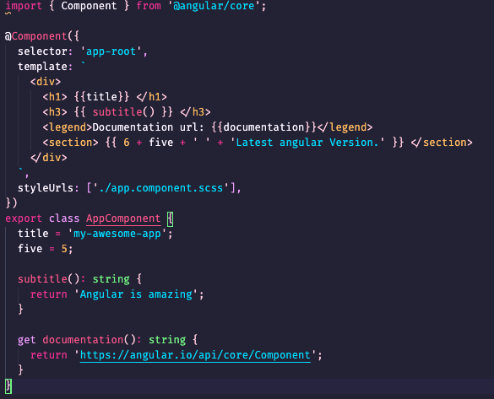
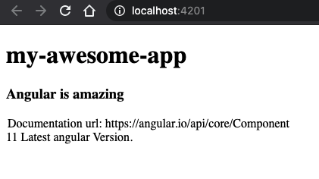
Components: string interpolation
How we saw before, we can bind the value of each property that can be parsed as a string to the template, this can be done through {{string}} syntax.

Slide 12
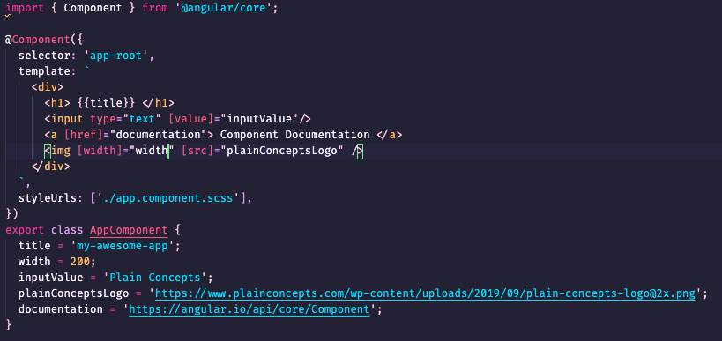
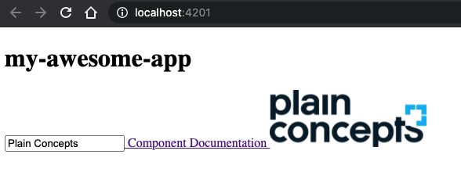
Components: Attribute data binding
Sometimes we need to bind the value of properties to some attributes (for example src, href, id…), for do this we use the [attributeName]=”property”.

Slide 13
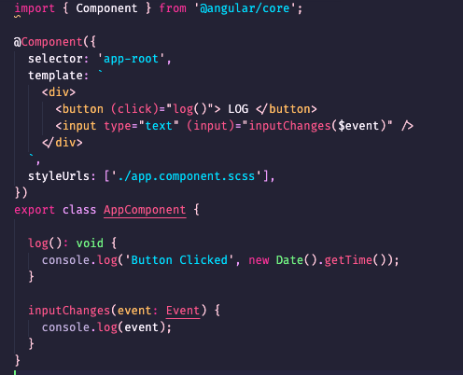
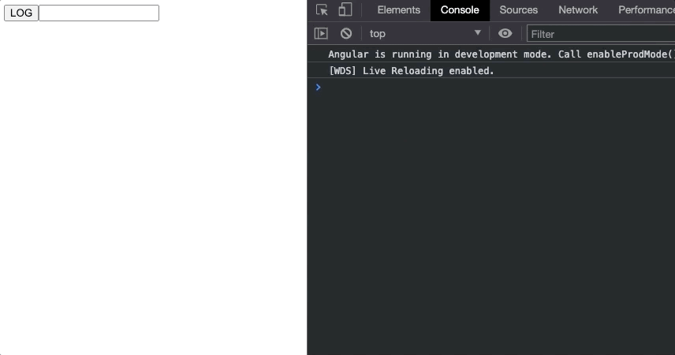
Components: Event binding
We can bind a method to an event that will emit some html element or component using the (eventName)=”methodName()” syntax, we can set the param $event to receive the event in our method, (change).

Slide 14
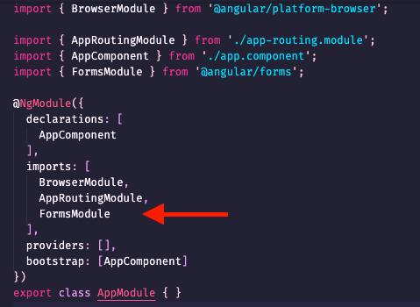
Components: Two way data binding - NgModel
In components sometimes we need to set a property to an element that will be modified by component.ts or by user interactions, in this case we need to use the two way data binding, we use the banana in a box syntax [(attribute)]=”property”.
The most common use of two way binding is with ngModel, for use this feature, we need to import the FormsModule in our module.

Slide 15
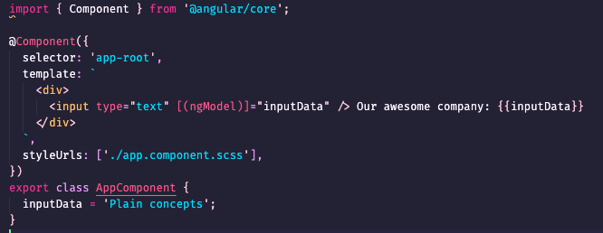
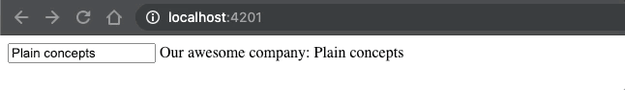
Components: Two way data binding - Use NgModel

Slide 16
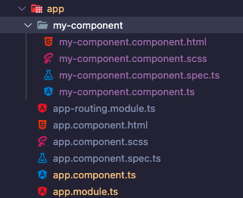
Components: How to create a component
The easier way to create a component is using the cli, how we see before cli, provide us a command to create angular application, but it’s not all, cli can create a components running the command: ng generate component my-component
This command generate for us, the boilerplate of our new component, with the .ts, .css, .spec.ts and .html file related to our new component.
This component is declared in app.module.ts.

Slide 17
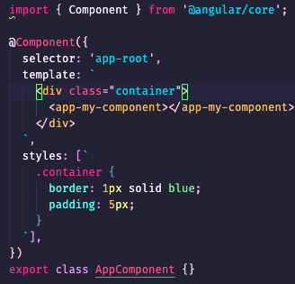
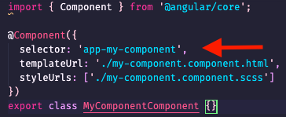
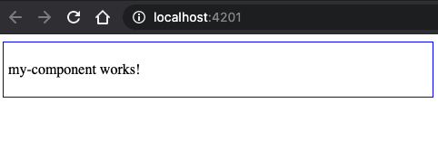
Components: How to use
For use a component inside another, we need to use the component selector as html directive.

Slide 18
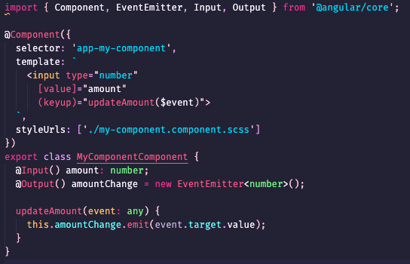
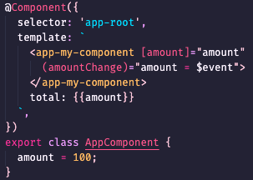
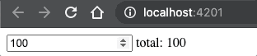
Components: Communication between them
Our application will be composed with a bunch of components and they need to communicate with their parent or children to passing some info or reacting to events, to do this, angular provide us the decorators @Input to pass data to children and @Output to listen event.

Slide 19
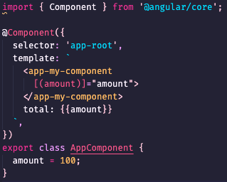
Components: Custom two way data binding
If we define an @Output in component with the same name of an @Input + “Change”, we can use this attribute as two way data binding.

Slide 20
Components: Life cycle
Angular provide us some lifecycle hooks that are executing during life of component.
ngOnChange: Is executed each time the inputs values change or change detector is triggered.
ngOnInit: Is triggered when the component is initialized, is called once after the first ngOnChange completes.
ngDoCheck: Detect and act upon changes, is called immediately after ngOnChanges.
ngAfterContentInit: Respond after angular project external content into the component, called once after first ngDoCheck.
ngAfterContentChecked: is executed after content init.
ngAfterViewInit: Respond after DOM elements are initialized, called once after ngAfterContentChecked.
ngAfterViewChecked: When the view is checked, called after ngAfterViewInit.
ngOnDestroy: Is called when the component is destroyed.

Slide 21
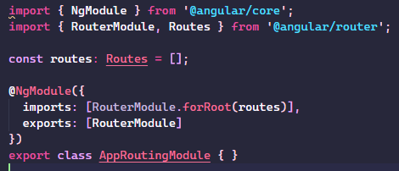
Components: Routing module
Angular has a module for create navigation between views(components), if when you create an application select the option of you want to use routing, now you have the file app-routing.module.ts with this content.
If you don’t select this option, no worry about it, just create a file with this name, copy this lines and add into app.module.ts imports.

Slide 22
Components: Generating routes
In app-routing.module.ts we have an array of routes, a route is composed basically by two properties path and component.
path: String that represent our route.
component: we bind the component we want to renderize when we put this route on browser.
As path you can use wildcards like “**” that represent every route that is not defined and the property redirectTo with the route we want to redirect.

Slide 23
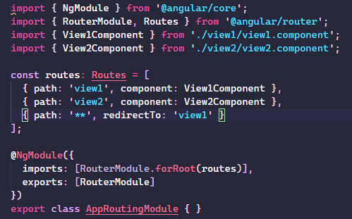
Components: Generating routes
To create a navigation we need more components, we can create easily running: ng g c view1 and ng g c view2 (**).
**: g in cli commands is a shortcut of generate and c for component.

Slide 24
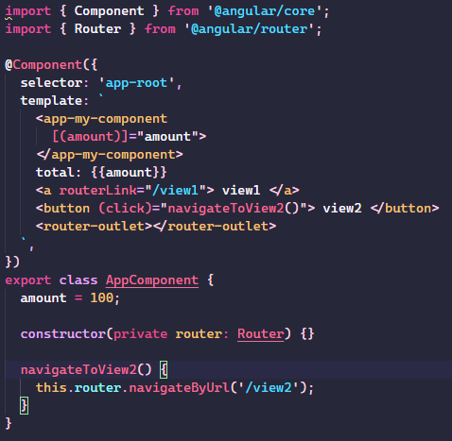
Components: Navigating between routes
We have basically two ways to navigate between components.
routerLink: is an attribute you can bind in some html element with an string that represent the path we want to navigate.
router: service that we can inject in our component an call some methods to navigate to other component.
We need to put in our template the directive router-outlet where we want to renderize the routing components.

Slide 25
Directives
Directives are classes that add additional functionality to html elements, the directive are divided in three groups.
Components: In essence a component is a directive with template.
Attribute: Directives that can change the appearance or behavior or an element, component or another directive.
Structural directive: This directives can change the DOM layout adding or removing elements.

Slide 26
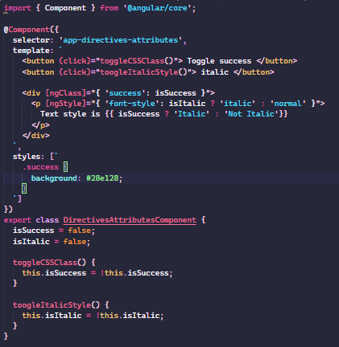
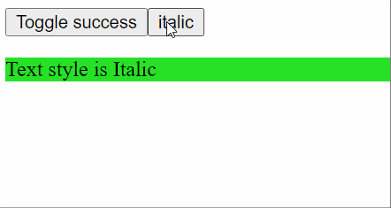
Directives: Attribute
Angular provide us some attribute directives to change appearance or accessing to new capabilities to elements.

Slide 27
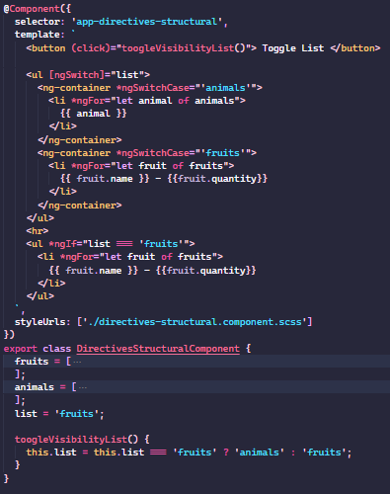
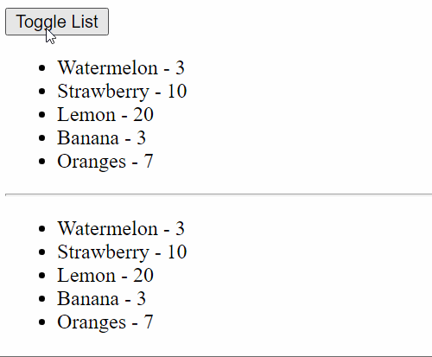
Directives: Structural
Angular provide us some structural directives that allow us to show or hide element or create a set of elements depends on iterable object.

Slide 28
Pipes
Pipes are function that can be used directly in template to transform values, angular provide us the next ones.
DatePipe: Formats a date value.
UpperCasePipe: Transform text to upper case.
LowerCasePipe: Transform text to lower case.
CurrencyPipe: Transform a number to a currency string.
DecimalPipe: Transform a number into a string with a decimal point.
PercentPipe: Transform a number to a percentage string.
AsyncPipe: This is a especial pipe, it receive an observable the pipe is subscribed to the observable and return all the values emitted by observable to the template, the same pipe is responsible to unsubscribe from observable.

Slide 29
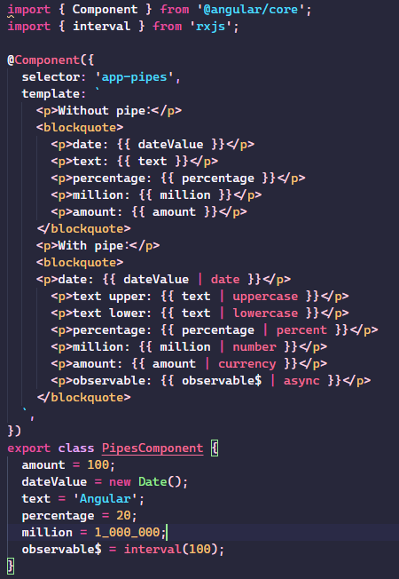
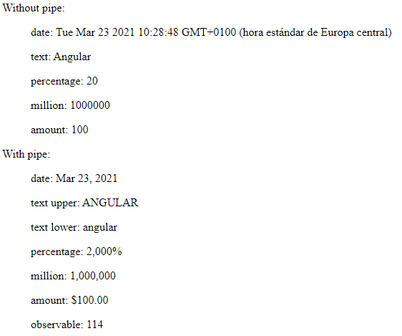
Pipes: How to use
We can add a pipe in every place we set a property in template with the syntax propertyName | pipeName.

Slide 30
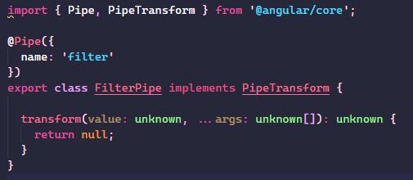
Pipes: Custom pipes
We can create our custom pipe to make the transform that we need for example apply a filter in some list.
Pipe is a class that implements PipeTransform, the method transform receive the value, some optional args and return a value.
For create a pipe running: ng generate pipe my-pipe (**).
**: we can use p instead of pipe in cli command.

Slide 31
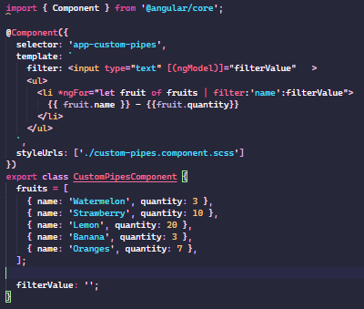
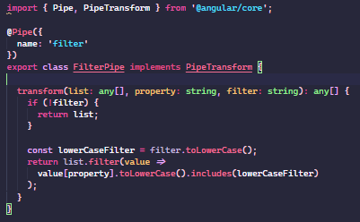
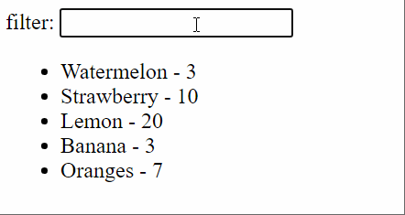
Pipes: Custom pipes - filter pipe

Slide 32
Services
The services are classes that encapsulates some business logic, access to server data (http, ws…), with well-defined purpose, it should do something specific and do it well.
It can be used by components, directives, pipes, other service or everything else, they are helped with dependency injection to be injected where we need, this let to the services a lot of possibilities to be reused.
We can create a service running: ng generate service my-service (**).
**: we can use s instead of service in cli command.

Slide 33
Services
Service use the @Injectable decorator to let angular know that this classes is managed by dependency injection.
The @injectable decorator, admit an object as param with the property provideIn, this property can have three options.
root: This service automatically injected in root injector, that let us the possibility of use in any piece inside our application.
platform: Creates a service as a singleton that can be used in all applications.
any: Set a unique instance in each lazy loaded module and only one in for all modules eagerly loaded.

Slide 34
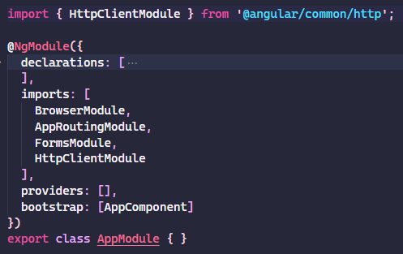
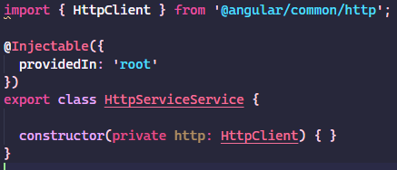
Services: Http Service
Angular has a http client, to use it in any place, we need to import the HttpClientModule into app.module.ts
When the HttpClientModule is available in your application, it delivers the HttpClient as an injectable service.

Slide 35
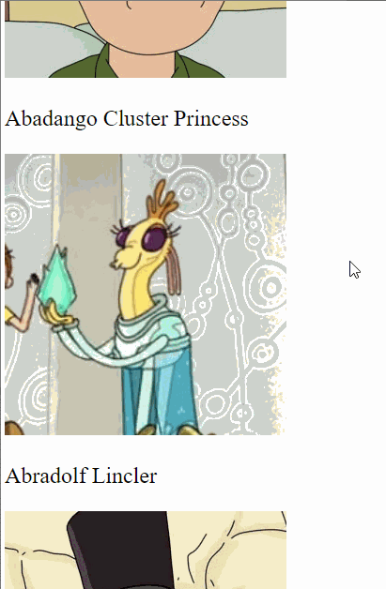
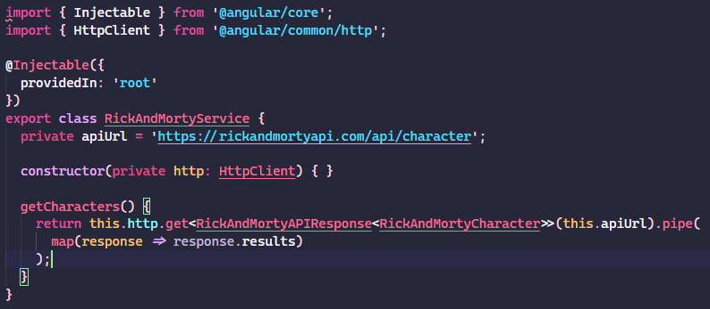
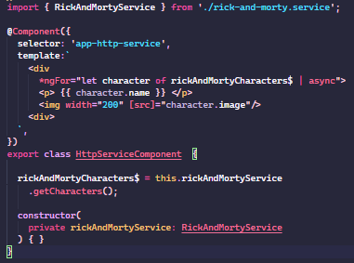
Services: HttpClient
The http client has many methods for every HTTP method, get, post, put, patch, delete, all this methods return a RxJS Observable, we need to subscribe it to receive the data.

Slide 36
Modules
Modules are the form of group some of the other elements we saw before that are related among them (feature).
For example: we need an users feature that will have view of users list, view of users detail, service to retrieve users from DB, filter to search user by name…, this case is the perfect candidate to be a module.
We can create a module running the command: ng generate module moduleName (**).
**: we can use m instead of module in cli command.

Slide 37
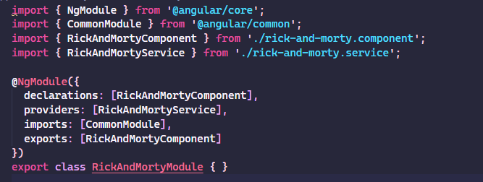
Modules: Anatomy
The modules are classes decorated with @NgModule decorator, this decorator accept several properties.
imports: Array of modules that we need in our module.
providers: Array of services.
declaration: Array of components/pipes/directives defineds in this module (one element only can be declared in one module).
exports: Array of exported components/pipes/directives to use in other modules.

Slide 38
Modules: Lazy loading
The modules allow us the possibility to lazy load it, when we inject into imports property of module another module we are telling angular that this module needs the other then this code in setted in the same bundle file to load together, but when we create a bunch of view is very possible that we only need the elements to render this view, here is where lazy loads come to enlighten us.
This feature delivers to us a files more little that browser will need to discharge when we access to an application this it will improve the performance and loading time.

Slide 39
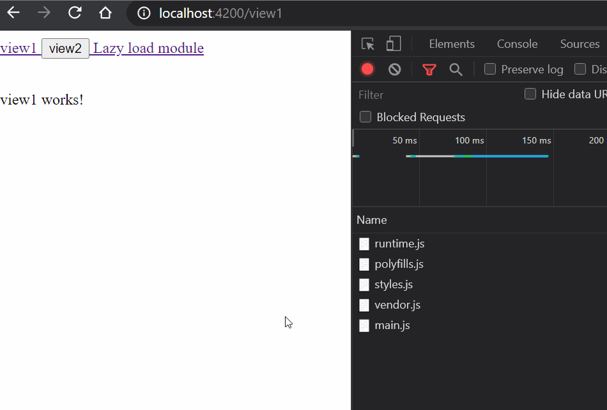
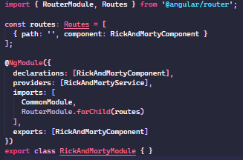
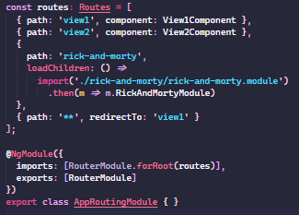
Modules: Lazy loading - how to implement
To implement lazy load is very easy, first of all we need to add routing to a module that we want to load lazily.
Is important to instantiate as forChild routes, this is because this only manage the children routes of this module but needs an root routing calling it.
To finish we need to declare in the forRoot routes but instead of use component property we use loadChildren and dynamic import.

Slide 40

Q&A

Slide 41


